Slide 1

Image Classification with CNN (Convolutional Neural Networks)
Welcome to an insightful journey into the world of Image Classification, powered by the marvels of Convolutional Neural Networks.

Slide 2

What is Image Classification?
Image classification is the process of assigning a meaningful label to an entire image, allowing machines to "see" and interpret visual data much like humans do. This foundational AI task underpins many modern technologies.
Assigning a descriptive label to an entire image, such as "cat" or "dog," enables machines to understand visual content.
This technology powers everyday applications like seamless face recognition on smartphones and advanced navigation systems in self-driving cars, making our lives smarter and safer.
A recent 2024 study showcased the remarkable capability of CNNs, achieving over 99% accuracy in classifying American Sign Language hand postures, highlighting their precision and potential.

Slide 3
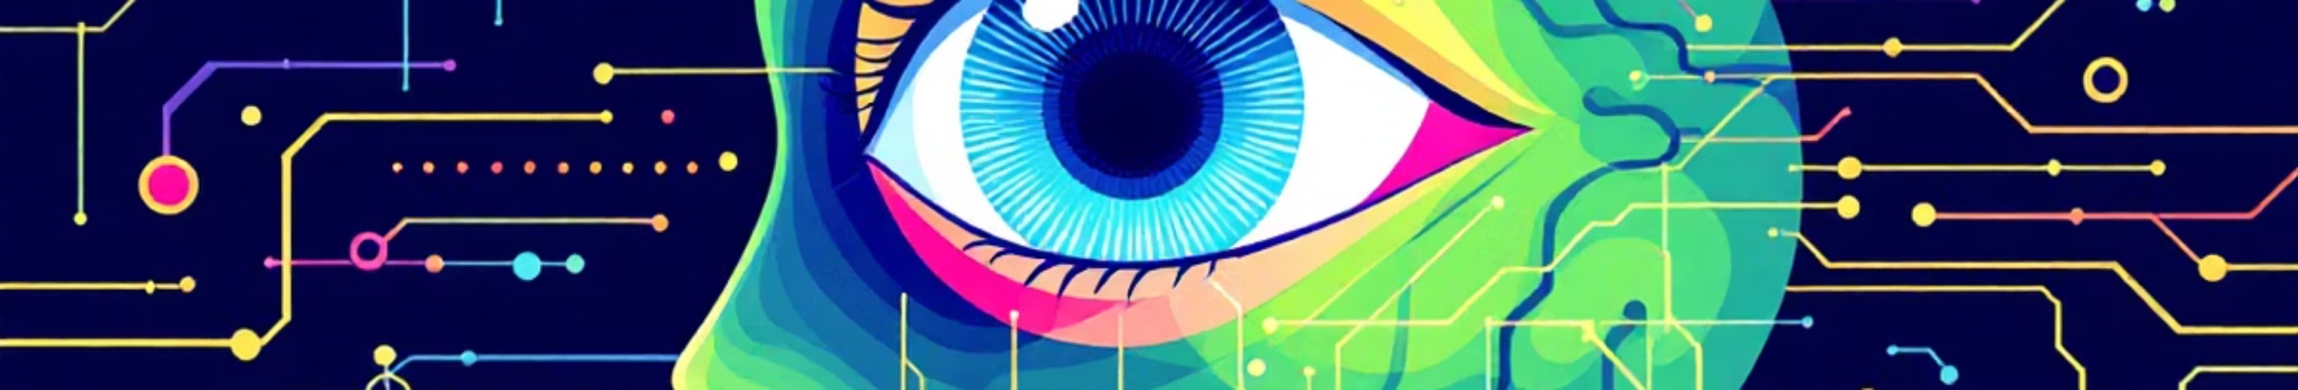



Why CNNs for Images?
Traditional machine learning struggles with images because it treats each pixel as an independent data point, losing crucial spatial relationships. CNNs, however, are specifically designed to overcome this limitation.
Traditional ML Limitations
Mimicking Human Vision
Feature Extraction
Treats pixels independently, ignoring their spatial arrangement and context, leading to loss of vital information.
CNNs operate similarly to the human visual cortex, processing information in hierarchical layers to build a comprehensive understanding.
They employ learnable filters that scan images, adeptly identifying key visual features like edges, textures, and distinctive shapes.

Slide 4
Core CNN Architecture: The Building Blocks
Understanding the fundamental layers of a CNN is key to grasping how they process and classify images. Each layer plays a distinct, crucial role in transforming raw pixel data into meaningful predictions.
01
02
03
Convolutional Layer
Pooling Layer
Fully Connected Layer
This initial layer extracts fundamental features by applying learnable filters that slide across the input image, detecting patterns such as edges and corners.
Following convolution, this layer reduces the dimensionality of the feature maps, retaining the most critical information while making the model robust to slight shifts or distortions in the image.
The final stage flattens the processed features from previous layers and connects them to output neurons, which then classify the image into predefined categories.

Slide 5

How CNN Learns Automatically
One of the most powerful aspects of CNNs is their ability to learn features directly from data, eliminating the need for manual feature engineering. This automatic learning process is central to their effectiveness.
No Manual Feature Design: Unlike traditional methods, CNNs autonomously discover and learn relevant patterns and features from vast datasets of images.
Hierarchical Feature Learning: Early layers of the network focus on detecting simple, primitive features like edges, lines, and colour gradients.
Complex Feature Construction: As data progresses deeper into the network, these simple features are combined to recognise more intricate patterns, shapes, and ultimately, entire objects.
Error Minimisation: The training process involves backpropagation, an algorithm that iteratively adjusts the network's internal parameters to minimise classification errors, thereby improving accuracy.

Slide 6




Popular Datasets for CNN Image Classification
The availability of diverse and well-annotated datasets is crucial for training robust CNN models. These datasets serve as the foundation for teaching machines to recognise and classify images effectively.
MNIST
CIFAR-10
Comprises 70,000 images of handwritten digits, each 28x28 pixels. It's an excellent starting point for beginners due to its simplicity and clear classification task.
Features 60,000 colour images categorised into 10 distinct classes, including airplanes, dogs, and trucks. It offers a more complex challenge than MNIST.
ImageNet
A monumental dataset with over 14 million images spread across 20,000+ categories. It's the benchmark for large-scale image recognition challenges.

Slide 7
Building a Simple CNN Model (Example)
Even with basic architectures, CNNs can achieve impressive results on standard datasets. Here's a simplified outline of how one might construct and train a CNN model.
Layer Stacking
Data Preprocessing
Construct the network by sequentially arranging layers: a Convolutional Layer, followed by a Pooling Layer, another Convolutional Layer, a second Pooling Layer, a Fully Connected Layer, and finally, an Output Layer.
Standardise image inputs by resizing them to a uniform dimension and normalising pixel values to a 0-1 scale for consistent model input.
Achieve High Accuracy
Model Training
With this basic architecture, one can easily achieve over 99% accuracy on datasets such as MNIST, demonstrating the efficiency of CNNs.
Feed the model with a large set of labelled images, utilising powerful Python libraries like TensorFlow or Keras to optimise its performance.

Slide 8

State-of-the-Art CNN Models in 2025
The field of CNNs is constantly evolving, with new models pushing the boundaries of accuracy, efficiency, and application-specific optimisations. Here are some of the leading architectures of 2025.
EfficientNetV2
Remarkably balances high accuracy with computational speed, making it an ideal choice for a diverse range of small to medium-sized datasets.
ConvNeXt
A contemporary CNN architecture inspired by transformer models, known for its strong accuracy and simplified training processes.
MobileNetV3
Specifically optimised for resource-constrained environments like mobile and edge devices, offering high performance with low power consumption and rapid inference.
Transformers
While models like ViT and Swin are gaining prominence, traditional CNNs still maintain their dominance in many critical applications.

Slide 9



Real-World Applications in India
In India, CNNs are being innovatively applied across various sectors, transforming how we interact with technology and improving critical services.
Food Recognition Apps: Pioneering applications utilise CNNs to classify a diverse range of Indian dishes with impressive accuracy, often exceeding 90% in training.
Medical Imaging: CNN-based classifiers are revolutionising diagnostics, assisting in early and accurate detection of diseases like cancer from complex medical scans.
Traffic Sign Recognition: Essential for the development of autonomous vehicles and intelligent urban infrastructure, CNNs enable precise recognition of traffic signs in varied environmental conditions.

Slide 10
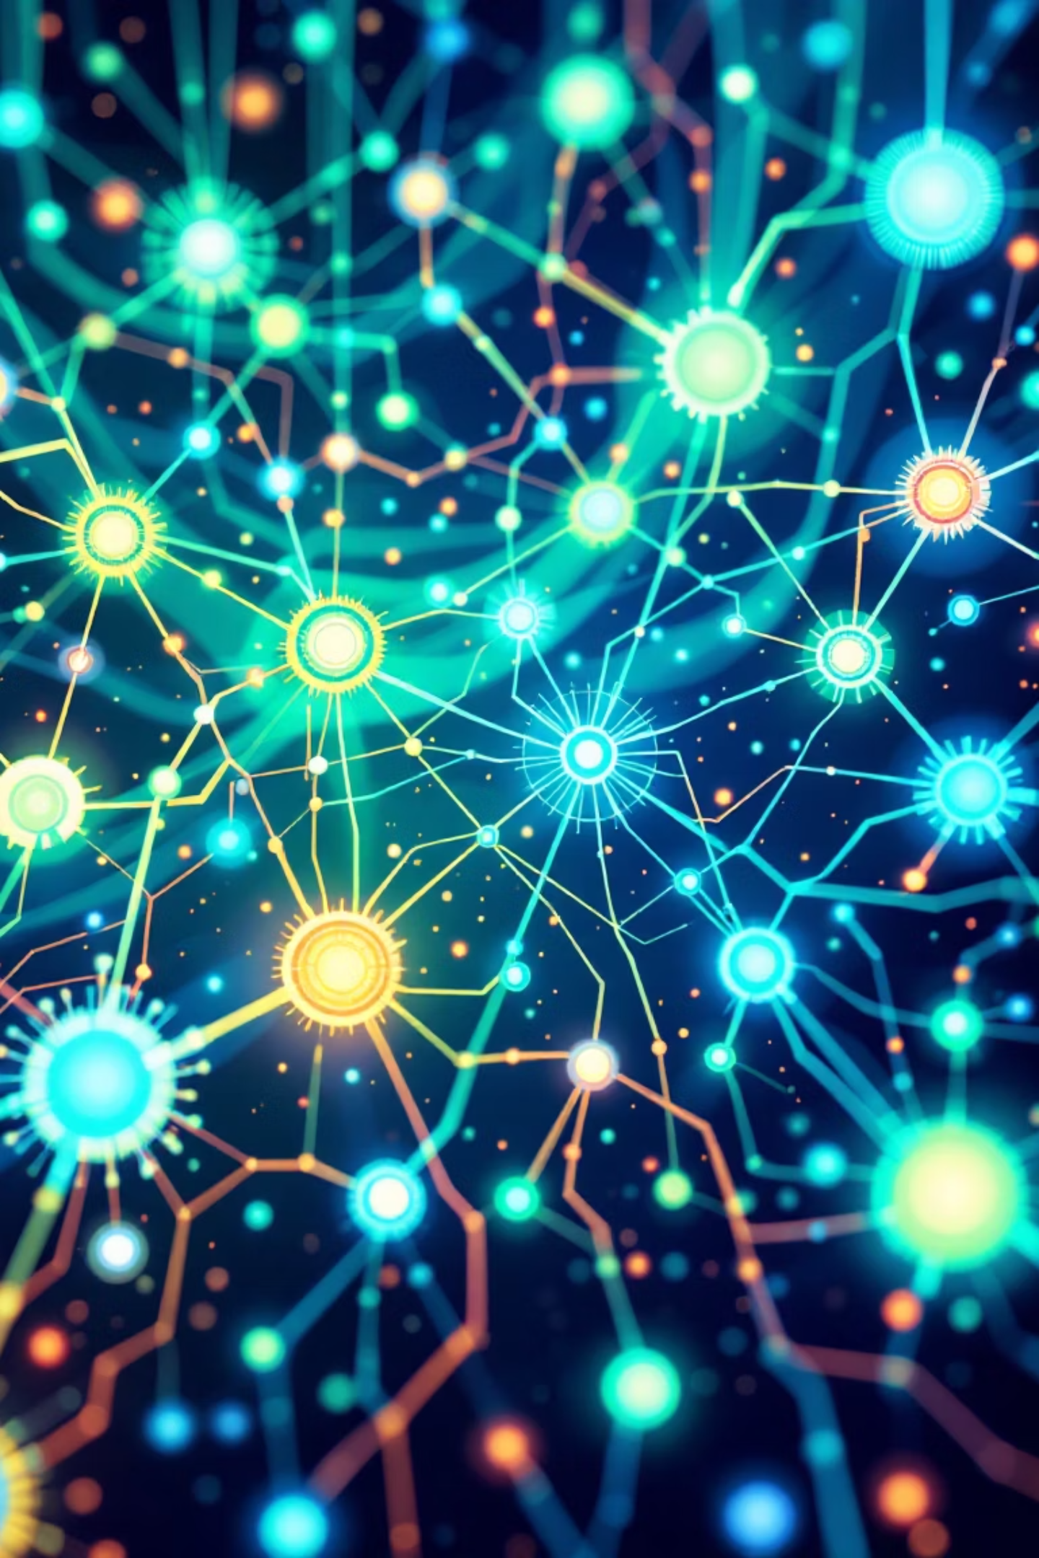
Conclusion: CNNs Powering Visual AI Today and Tomorrow
Convolutional Neural Networks have fundamentally reshaped the landscape of artificial intelligence, enabling machines to "see" and interpret the visual world with unprecedented accuracy and sophistication. Their impact is profound and continues to expand.
CNNs revolutionise how machines "see" and understand images, offering a transformative approach to visual AI.
From deciphering intricate handwritten digits to interpreting complex real-world scenes, CNNs consistently deliver human-level accuracy.
With continuous advancements and innovations, CNNs are poised to drive even smarter AI solutions across every industry imaginable.
Ready to delve deeper? Begin your own CNN journey by experimenting with foundational datasets like MNIST and CIFAR-10 today!

Slide 11
THANK YOU
MADE BY:-
SURYANSH MISHRA
PRITHVI RAJ MISHRA
VISHAL BHARGAVA
MUSTAK AHMED KHAN

